Slide 1

ASSIGNMENT #3 PRESENTATION Access Secure Sites
BDAT 1001 Informating Encoding Standards August 10, 2021
Daryoush Shabahang (200482375)

Slide 2
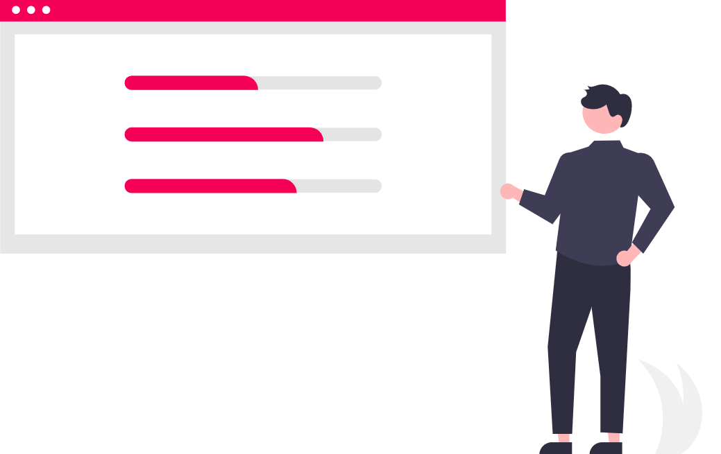
Talking Points
We will be discussing these:
1. Why do we need Authentication in Web API?
2. How Basic Authentication works in Web API?
3. How to implement Basic Authentication in ASP.NET Web API?
4. How to enable Basic Authentication in Web API?
5. Testing the ASP.NET Web API Basic Authentication using Postman (video)
Link to my YouTube private video: https://youtu.be/jfv88PfQV7g
© 2021 BDAT 1001 Assignment #3

Slide 3

Q1: Why do we need Authentication in Web API?
It's important to ensure that all of the data and credentials are secured and we need to avoid unauthorized people such as hackers from accessing confidential and sensitive data, i.e. usernames, passwords, employee details, etc.
Web API enables organizations to keep their networks secure and only permitting authenticated users to access data and resources. A request with the user’s credentials needs to be passed each time to ensure it’s correct and even up-to-date.
This is very important in today's world as more and more companies are getting hacked resulting in identity theft amongst other issues and serious consequences.
© 2021 BDAT 1001 Assignment #3

Slide 4

Q2: How Basic Authentication works in Web API?
These are just some of the ways:
Users send their unique credentials in the request header username/password or a token.
Once the user is verified with 200 OK, then they will be permitted to login or to do a task.
Otherwise, the user will be denied with a 401 (Unauthorized) error and they can try again.
© 2021 BDAT 1001 Assignment #3

Slide 5

Q3: How to implement Basic Authentication in ASP.NET Web API?
o I have followed all the steps in the assignment PDF to implement the code.
Added six different .cs models files in the “Models” folder.
“BasicAuthenticationAttribute.cs”
“Employee.cs”
“EmployeeBL.cs”
“User.cs”
“UserBL.cs”
“UserValidate.cs”
As well as added a “EmployeeController.cs” file in the “Controllers” folder.
o I have also customized the code to the best of my knowledge for this assignment.
In the “Employee.cs” file, I added “Age”, “Address”, “Phone”, and “Marital_Status”.
In the “EmployeeBL.cs” file, I added a random generator for each one, as well as an array.
i.e. each employee has an age 20 to 30 assigned, either a “Single” or “Married” marital status, a salary between $50,000 and $120,000, and an assigned department from the array: “Marketing”, “IT”, “HR”, or “Technical”.
In the “UsersBL.cs” file, I added additional users for each new department with their own unique “UserName” and “Password” assigned. I have also encoded all of them to Base64 which I will explain shortly.
© 2021 BDAT 1001 Assignment #3

Slide 6

What is Postman?
Postman is a popular and collaborative platform to help developers build, run, and distribute APIs.
It has several really great features and integrations to help developers. In fact, over 17 million developers and 500,000 companies use Postman - including Cisco, Intuit, Shopify, and more.
Since Postman has so many wonderful benefits, it helps developers create better APIs - faster!
© 2021 BDAT 1001 Assignment #3

Slide 7

Q4: How to enable Basic Authentication in Web API?
o We can enable this in several ways, such as using the BasicAuthenticationAttribute.
o This can be added on a specific controller, action, or even globally for all Web API controllers.
o In our assignment, this has been enabled at the action method level via [BasicAuthentication]
o In addition, the EmployeeController will switch between the different users.
© 2021 BDAT 1001 Assignment #3

Slide 8

Base64 Authentication Codes
Male:
BASIC TWFsZVVzZXI6MTIzNDU2
Female:
BASIC RmVtYWxlVXNlcjphYmNkZWY=
Marketing:
TWFya2V0aW5nOjEyMzRta3Q=
IT:
SVQ6MTIzNGl0
HR:
SFI6MTIzNGhy
Technical:
VGVjaG5pY2FsOjEyMzR0ZWNo
© 2021 BDAT 1001 Assignment #3

Slide 9

© 2021 BDAT 1001 Assignment #3

